Slide 1
Digital Transformation in Manufacturing: The Case of General Electric (GE)
ALY 6060 – Decision Support and Business Intelligence
Final Project Presentation
Devi Somalinga Bhuvanesh
Gurrup Kaur Gurbir Singh Soi

Slide 2
Table of contents
01
Aim, Objectives and Methodology
02
General Electric Overview
03
Data Analytics Culture: Before and After
04
Application of AI and BI
05
Leadership and Sustainability
06
Conclusion and Recommendations

Slide 3
Aim, Objectives, and Methodology
Aim
To examine the significance of digital transformation in the manufacturing sector, with a specific focus on General Electric (GE) and its digital transformation initiatives through GE Digital.
Objectives
Investigate GE's data analytics culture, including their approach to data-driven decision-making and data governance practices.
Understand how GE utilizes AI and BI to drive business decisions and offer client products, assessing their impact on operations, reliability, and innovation.
Assess GE's readiness for Industry 4.0 and evaluate their global impact and potential for success.
Methodology
Qualitative Research of research publications, websites of GE, YouTube videos, news articles, and blogs.

Slide 4

General Electric
Founded in 1889 by Thomas A. Edison through by merging the Edison General Electric Company and the Thomson-Houston Company.
American company with a global presence and headquarters in Boston
Operating in over 170 countries, with strong brand and customer relationships
Key Industries: Power, Renewable Energy, Aviation, Healthcare
Cutting-Edge Solutions: Additive Manufacturing, Materials Science, Data Analytics
Publicly traded since 1896 on the New York Stock Exchange (NYSE: GE)
“We rise to the challenge of building a world that works.”

Slide 5

General Electric Digital
Established in 2015 as a subsidiary of General Electric (GE)
Purpose: Drive digital transformation in manufacturing and industrial sectors
Key Focus Areas: Software solutions, data analytics, and industrial automation
Leveraging the power of data and technology to enhance operational efficiency
Harnessing the Industrial Internet of Things (IIoT) to optimize processes
Promoting innovation, competitiveness, and customer-centric solutions
Real-world impact through cost savings and improved productivity

Slide 6
Before Data Analytics Culture
Limited Use of Data in Decision-Making
Data and Information Silos
Lack of Data Literacy and Skills
GE's data and information were stored in separate silos across departments, hindering collaboration and limiting effective data utilization.
GE faced challenges in finding employees with the necessary data literacy skills, hampering the organization's ability to extract meaningful insights from available data sources.
GE's decision-making processes relied more on experience and intuition rather than data and analytics,
Manual Reporting and Analysis
Limited Data-Driven Innovation
GE's manual data collection and analysis processes lacked real-time insights, limiting responsiveness to market dynamics.
GE underutilized data for innovation and missed opportunities in trend identification, customer preferences, and operational efficiencies.

Slide 7
After Data Analytics Culture
Data-Driven Decision-Making
Integrated Data Management
Advanced Analytics and AI Adoption
Enable informed decision-making, optimized strategies, risk mitigation, and new opportunities through analytics.
Enable collaboration and effective analysis by providing a unified view of operations across departments.
Used for proactive decision-making, leveraging machine learning, predictive models, and real-time data processing.
Data Infrastructure Investments
Data-Driven Innovation
GE's investments in cloud computing and big data technologies have enhanced data infrastructure, enabling faster and more efficient data analysis and utilization.
GE identifies trends, enhancing products, and exploring new opportunities for growth.
Data Governance & Quality Management
GE implements robust data governance for accurate, secure, and high-quality data through standards, cleansing processes, and privacy protocols.

Slide 8
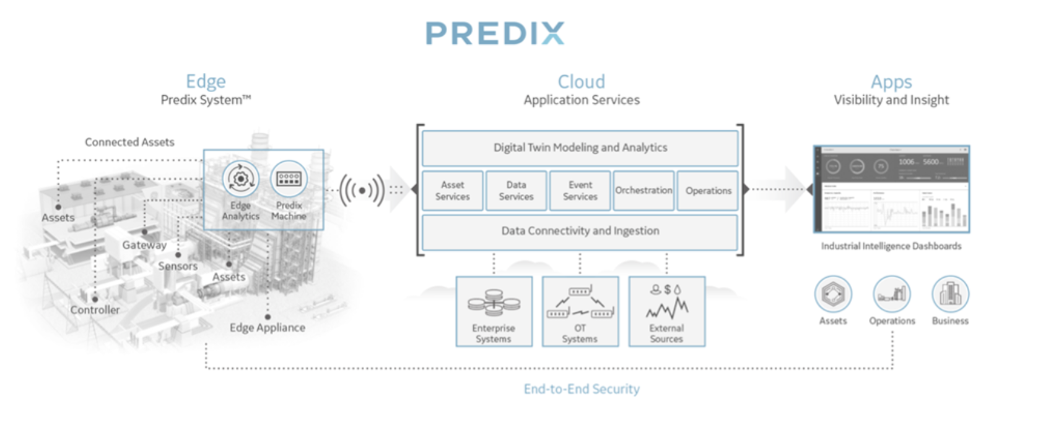
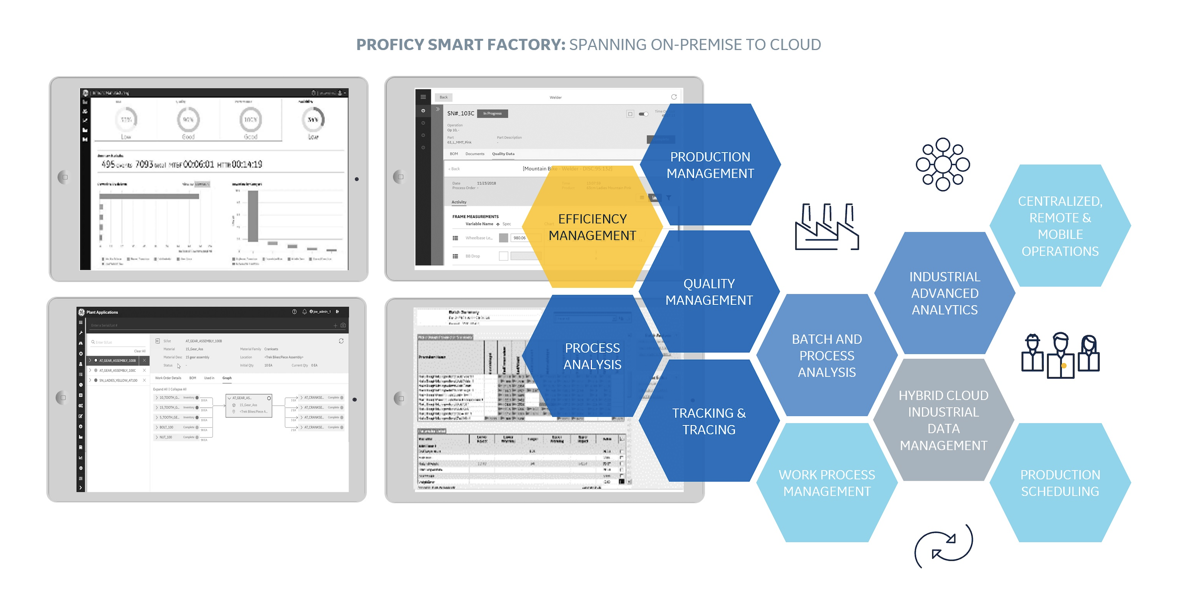
Application of AI and data analytics at GE
PREDIX
GE's Predix is an IoT platform for industrial companies, facilitating data collection, analysis, and optimization for improved operational efficiency.
Source: How Does Predix Machine Fit into the Predix Platform? | Predix Edge Documentation | GE Digital. (n.d.).
PROFICY SMART FACTORY
Proficy Smart Factory (MES) enables holistic performance management in manufacturing through data integration, IIoT, machine learning, and predictive analytics.
Source: Proficy Smart Factory from GE Digital Transforms Manufacturing Efficiency, Quality and Throughput Through Insights and Intelligence | GE News. (n.d.)

Slide 9
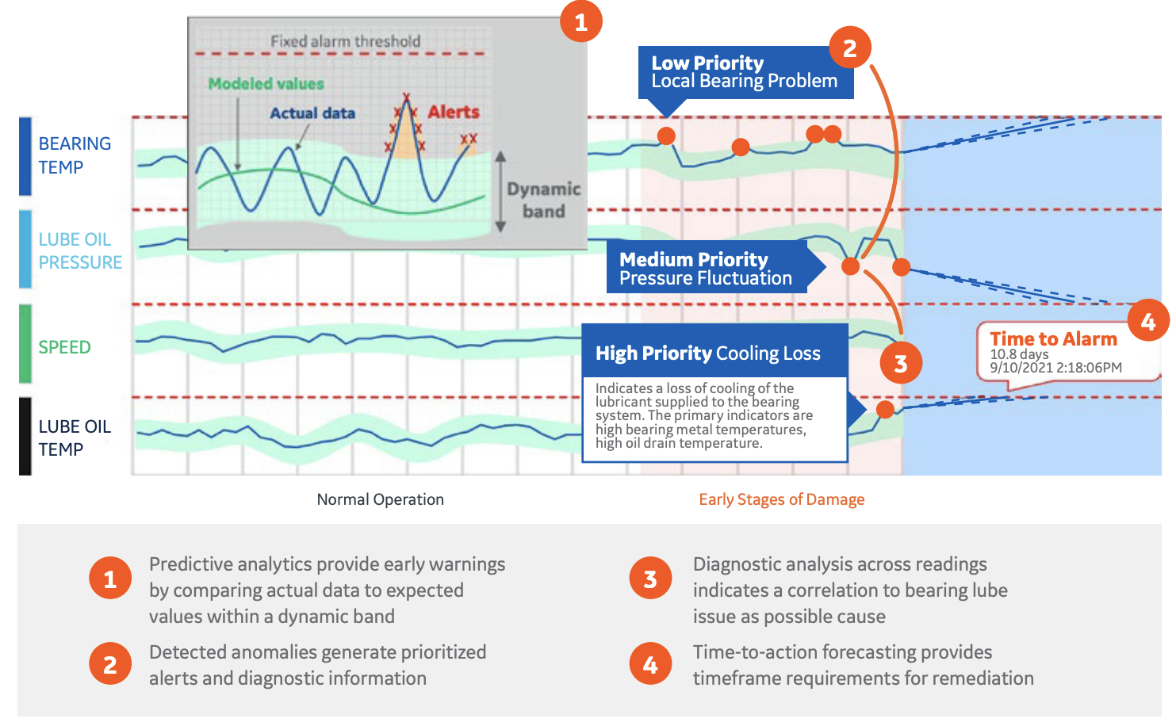
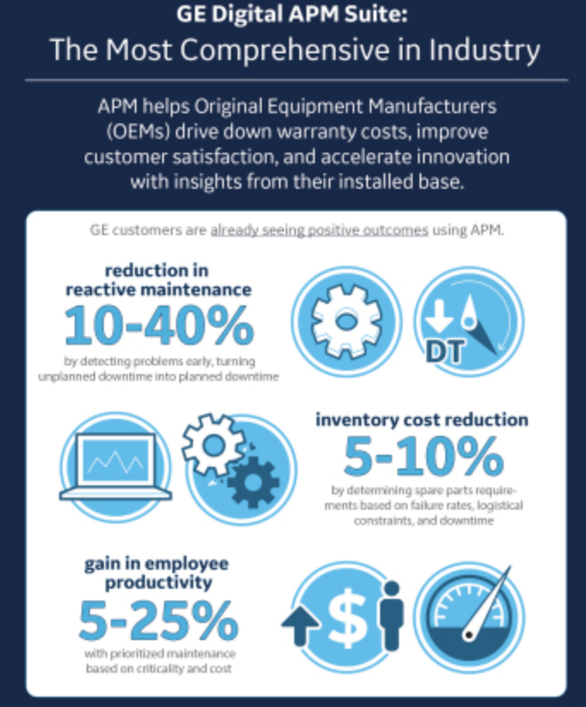
Application of AI and data analytics at GE
SMART SIGNAL
A predictive analytics software, helping prevent equipment downtime by detecting, diagnosing, forecasting & preventing emerging failures
Asset Performance Management
Optimizes asset performance and efficiency with Digital Twin analytics, work process automation, and industry expertise for modern industrial operations.
Source: GE Digital’s SmartSignal Now Offers Time-to-Action Forecast Analytics. (n.d.).
Source: GE Digital announces latest version of its Asset Performance Management solution. (n.d.).

Slide 10
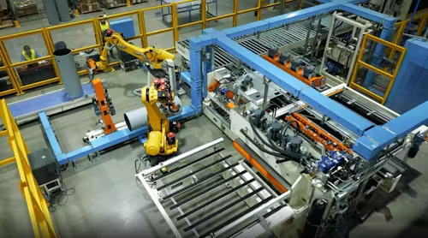
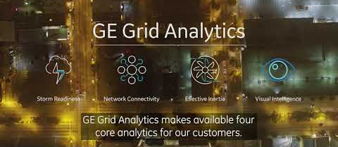
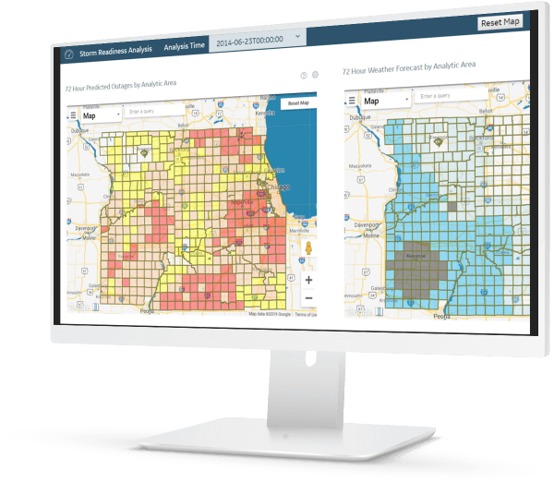
Application of AI and data analytics at GE
GRID ANALYTICS
Robotics and Automation
Optimize power networks, and storm readiness, providing real-time data-driven recommendations and improving decision-making for clients.
GE employs AI and robotics in manufacturing to automate tasks, enhance precision, and improve efficiency and safety.
Source: StackPath. (n.d.).
Source: Grid Analytics Software | Energy Analytics | GE Digital. (n.d.).

Slide 11
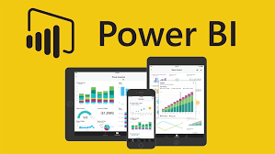
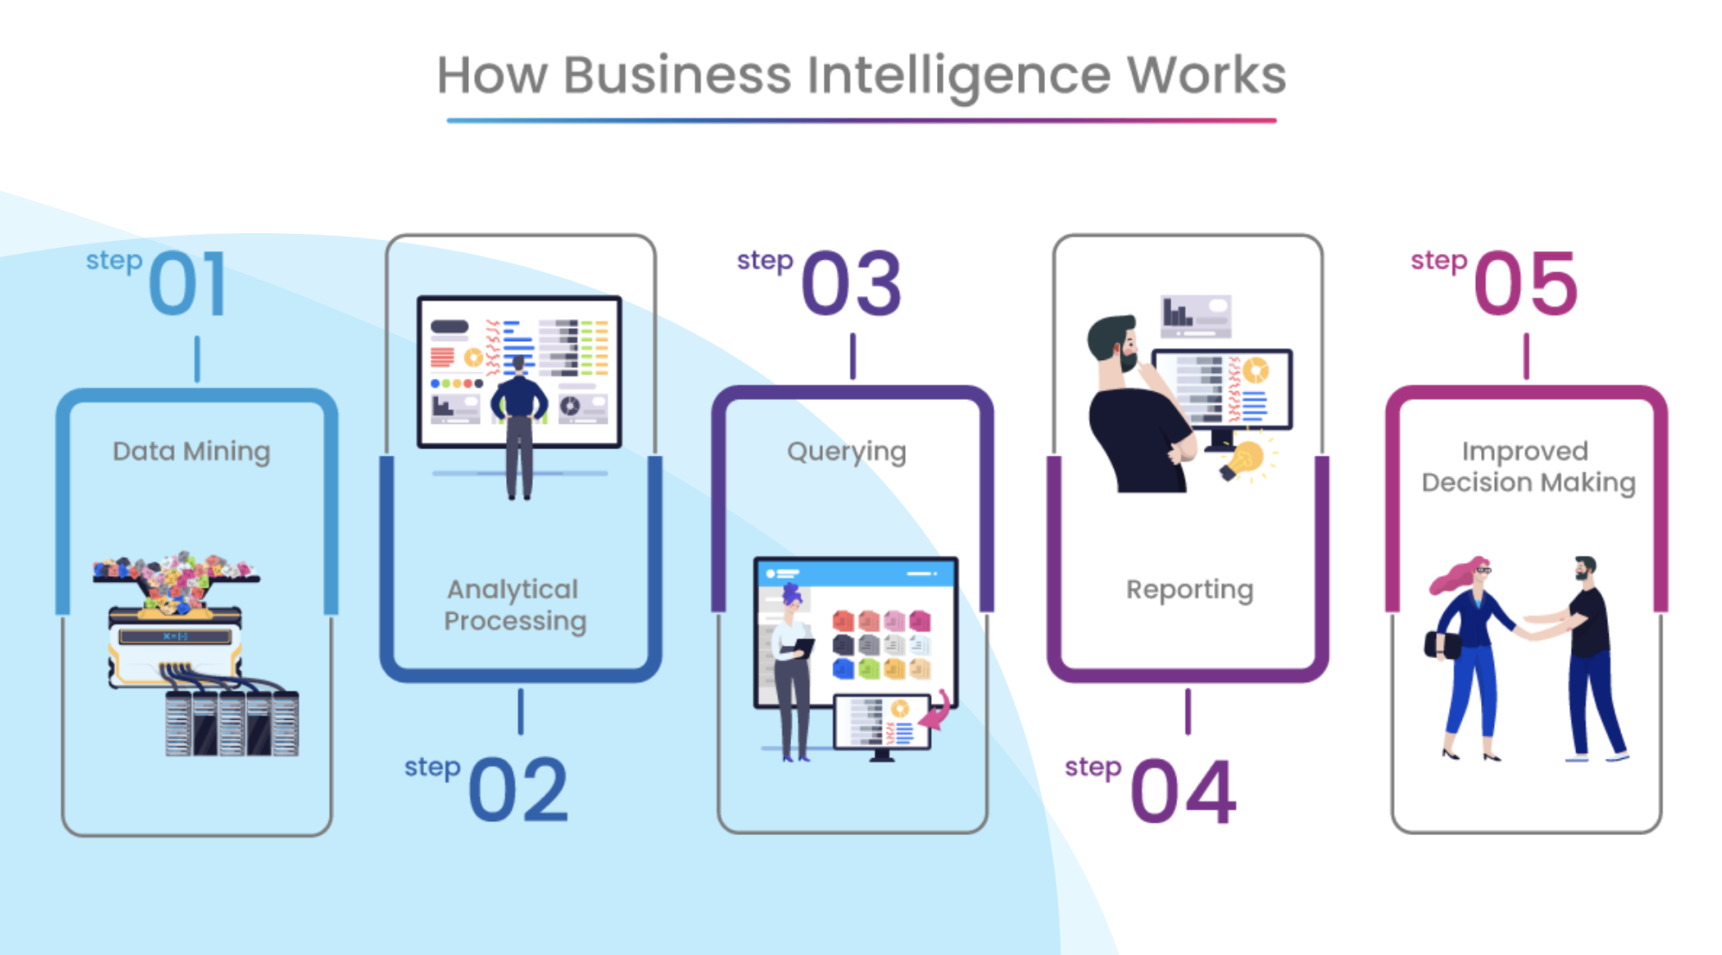


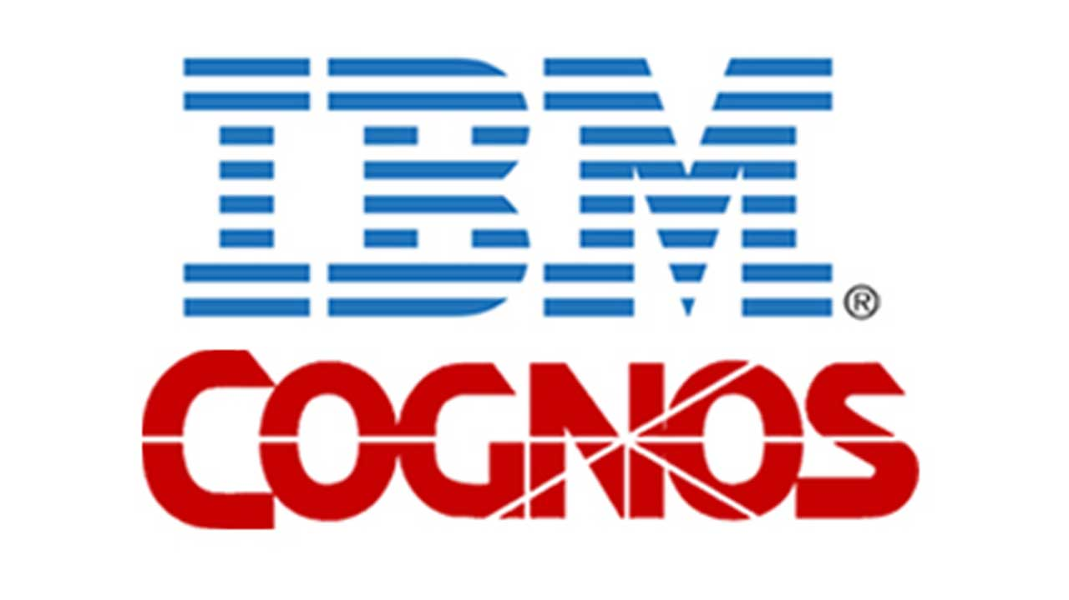
Application of BI and data analytics at GE
Source: Cspo, M. a. U. S. (n.d.).

Slide 12
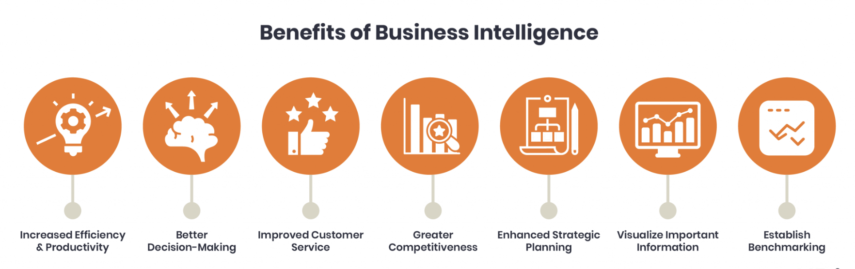
Application of BI and data analytics at GE

Slide 13
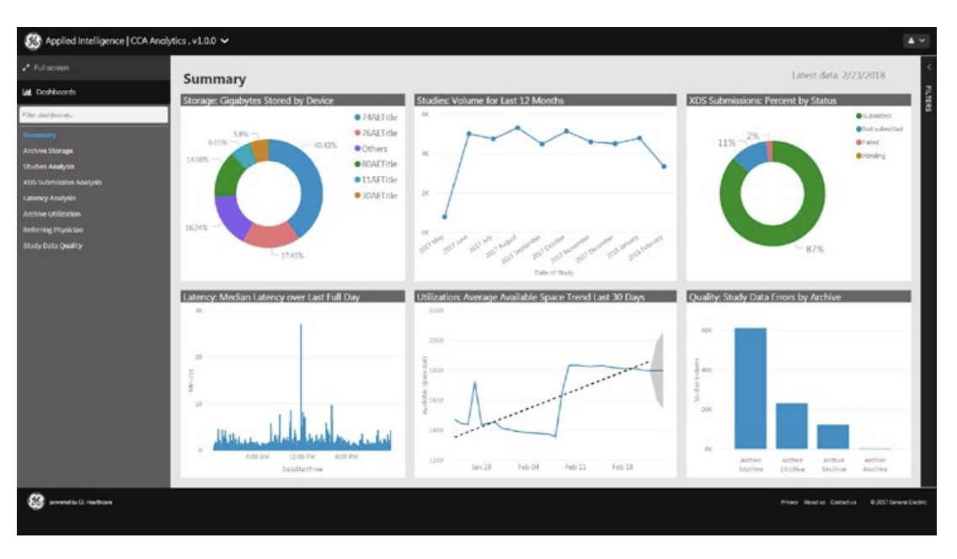
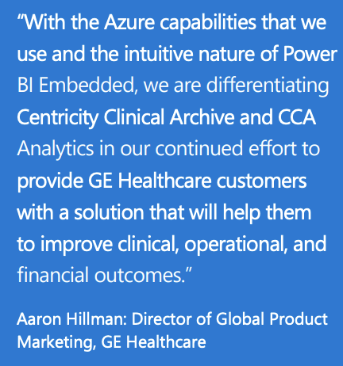
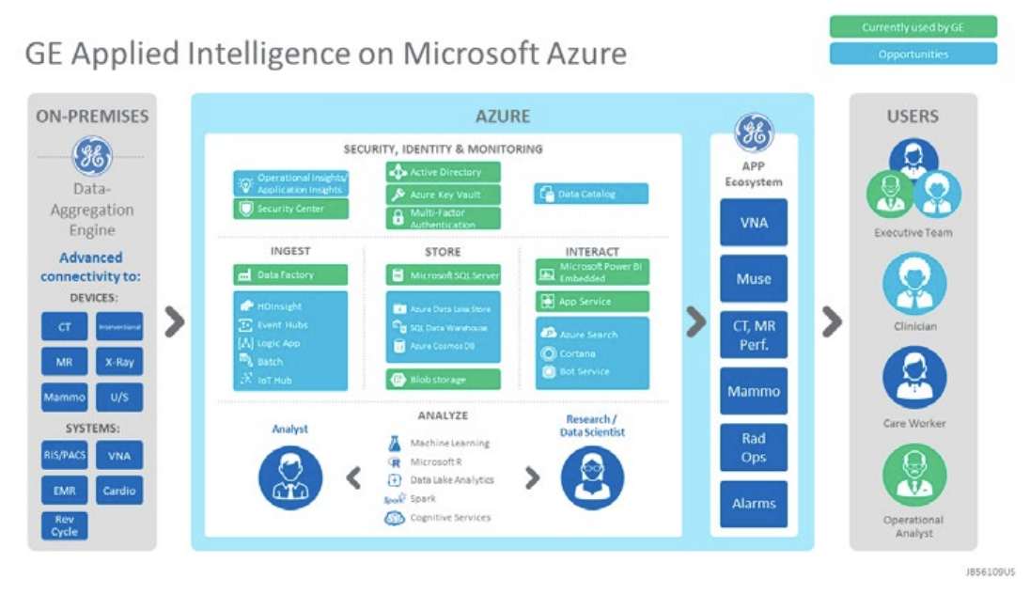
Case Study: GE Healthcare Transforms Healthcare with BI and Data Analytics
Need for the study:
Inefficient storage, retrieval, and analysis of patient data in medical imaging.
Need to enhance Centricity Clinical Archive (CCA) for improved patient care.
Solution:
Implementation of Centricity Clinical Archive Analytics - Unique cloud-based analytics solution.
Built on Microsoft Power BI Embedded as the business intelligence platform.
Microsoft Azure and Power BI Embedded chosen for agility, efficiency, and ease of development.
Implementation:
Pilot test conducted with a leading academic medical center.
Feedback from IT department used to refine functionality and usability.
Results:
Valuable insights into archive usage and better decision-making.
Correct metadata improved the number of "diagnosis-ready" assets.
Clinicians benefit from a comprehensive patient view, enabling informed decisions.
Source: GE Healthcare develops medical analytics solution in the cloud for better clinical outcomes. (n.d.). GE Healthcare.

Slide 14
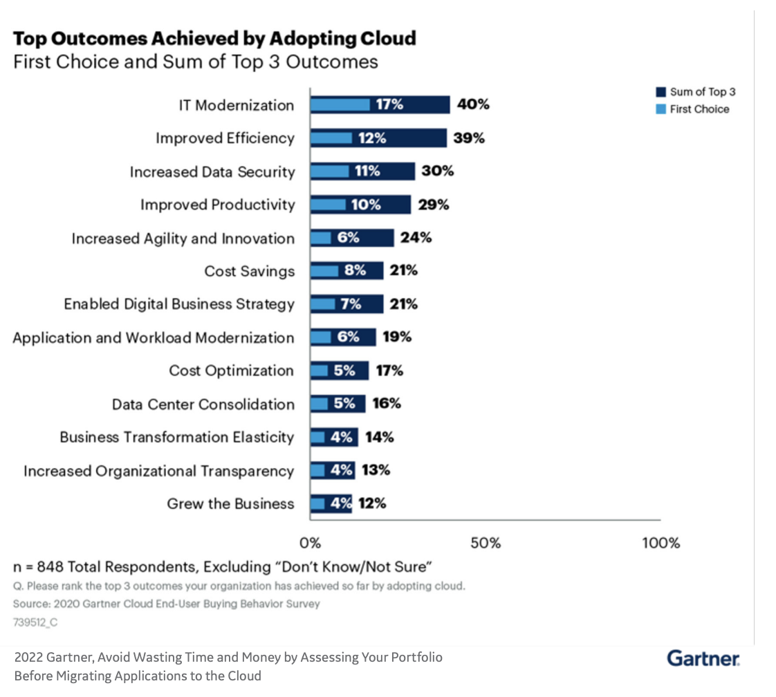
By leveraging AI, data analytics, and business intelligence, GE gains valuable insights, optimizes operations, improves reliability, and delivers innovative products, empowering data-driven decision-making and enhancing customer value.

Slide 15
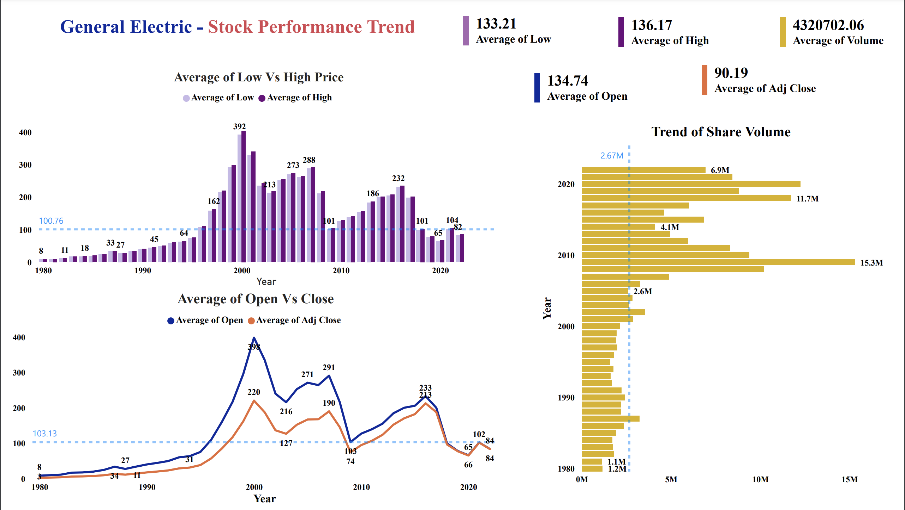
Data Source: General Electric Stock Company Dataset., 2022

Slide 16
Industrial Revolution 4.0 Leadership
Global Needs and Sustainability
Strategic Partnerships Continuous Innovation Sustainability Focus Customer-Centric Approach Cybersecurity Strengthen Data Analytics Capabilities
Energy Efficiency Solutions Renewable Energy Technologies Digital Solutions for Efficiency Oil and Gas Optimization Healthcare Innovations Infrastructure Development

Slide 17
CONCLUSION & RECOMMENDATIONS
GE Digital
Impact
Leading digital transformation in the manufacturing industry.
Software solutions and support for customer optimization efforts.
Enhanced innovation and productivity.
Waste reduction and sustainability efforts.
Key Initiatives
Leadership
Embracing Digital Transformation
Predix Platform: Industrial IoT platform for data analysis.
Digital twin technology: Virtual models for performance optimization.
Advanced analytics, AI, smart manufacturing, and automation.
Expanded digital solutions and services.
Positioned as an industry leader in industrial IoT.
Driving innovation through digital integration.
Data analytics, collaboration, and agility are integrated into GE's culture.
Improved operational efficiency and empowered workforce.

Slide 18
References
Daecher, A. (n.d.). Industry 4.0 Is Here - Has Your Company Adopted It? | GE Digital. https://www.ge.com/digital/blog/industry-40-here-has-your-company-adopted-it
Digital, G. (n.d.). If We Want to Build the Factory of the Future, We Need to go Beyond Industry 4.0 | GE Digital. https://www.ge.com/digital/blog/if-we-want-build-factory-future-we-need-go-beyond-industry-40
General Electric. (2022, August 3). GE Digital Is Transforming Manufacturing [Video]. YouTube. https://www.youtube.com/watch?v=_XH8Xr9OEOY
Vietnam Investment Review. (2017, November 20). GE’s digital transformation surfs the Industry 4.0 wave. Vietnam Investment Review - VIR. https://vir.com.vn/ges-digital-transformation-surfs-the-industry-40-wave-53956.html
GENERAL ELECTRIC: HOW CAN A 126-YEAR OLD INCUMBENT NAVIGATE THE FOURTH INDUSTRIAL REVOLUTION? - Technology and Operations Management. (2018, November 14). Technology and Operations Management. https://d3.harvard.edu/platform-rctom/submission/general-electric-how-can-a-126-year-old-incumbent-navigate-the-fourth-industrial-revolution/
GE Digital: Racing to Lead Industry 4.0 ^ IN1737. (n.d.). HBR Store. https://store.hbr.org/product/ge-digital-racing-to-lead-industry-4-0/IN1737
Digital, G. (n.d.-a). Data Analytics that Do More with What You Already Have | GE Digital. https://www.ge.com/digital/blog/data-analytics-do-more-what-you-already-have
Massachusetts Institute of Technology. (2014, January 27). GE and the Culture of Analytics | MIT Sloan Management Review. MIT Sloan Management Review. https://sloanreview.mit.edu/article/ge-and-the-culture-of-analytics/
Predictive Analytics Software | Prescriptive Analytics Software | GE Digital. (n.d.). https://www.ge.com/digital/applications/analytics
Parris, C. (n.d.). What is the Industrial Internet of Things (IIoT)? GE. https://www.ge.com/digital/blog/what-industrial-internet-things-iiot
Admin. (2023, May 8). General Electric Success Story [Infographic] | InfoClutch. https://www.infoclutch.com/infographic/general-electric-history-timeline
Gaille, B. (2013, November 8). Complete History of the General Electric (GE) Corporation - BrandonGaille.com. BrandonGaille.com. https://brandongaille.com/complete-history-the-general-electric-corporation/
ADVFN Login. (n.d.). https://uk.advfn.com/p.php?pid=actv_rem1

Slide 19
References
Kilgore, T. (2019, February 2). GE’s stock rockets to biggest gain in 10 years as CEO Culp embraces reality over hope. MarketWatch. https://www.marketwatch.com/story/ges-stock-gets-biggest-earnings-boost-in-over-10-years-2019-01-31
Finnegan, J. (2021, November 9). GE Plans to Form Three Public Companies Focused on Growth Sectors of Aviation, Healthcare, and Energy |. Aerospace Tech Review. https://www.aerospacetechreview.com/ge-plans-to-form-three-public-companies-focused-on-growth-sectors-of-aviation-healthcare-and-energy/
A Defining Moment: GE To Form 3 Industry-Leading Public Companies Focused On Aviation, Healthcare and Energy | GE News. (n.d.). https://www.ge.com/news/reports/a-defining-moment-ge-to-form-3-industry-leading-public-companies-focused-on-aviation
Anthonysmoak. (2018, November 26). General Electric’s Digital Pivot. Smoak Signals | Data Analytics Blog. https://anthonysmoak.com/2017/10/16/general-electrics-digital-pivot/
How Does Predix Machine Fit into the Predix Platform? | Predix Edge Documentation | GE Digital. (n.d.). (C) Copyright 2021. https://www.ge.com/digital/documentation/edge-software/c_How_Does_Predix_Machine_Fit_into_the_Predix_Ecosystem.html
General Electric Stock Company Dataset. (2022, August 4). Kaggle. https://www.kaggle.com/datasets/achmadbauravindah/general-electric-company-dataset
GE Healthcare develops medical analytics solution in the cloud for better clinical outcomes. (n.d.). GE Healthcare. https://www.itnonline.com/sites/default/files/GE_Healthcare_Microsoft_CCA_CaseStudy.pdf
Cspo, M. a. U. S. (n.d.). How Business Intelligence Works & Its Benefits. www.linkedin.com. https://www.linkedin.com/pulse/how-business-intelligence-works-its-benefits-md-aftab-uddin-cspo-/
Grid Analytics Software | Energy Analytics | GE Digital. (n.d.). https://www.ge.com/digital/applications/grid-analytics
Jarrell, M. (2021). Artificial Intelligence and Digital Twins at General Electric. Emerj Artificial Intelligence Research. https://emerj.com/ai-sector-overviews/ai-at-general-electric/
StackPath. (n.d.). https://www.industryweek.com/technology-and-iiot/article/21241556/new-ge-appliances-plant-features-extensive-robotics-deployment
GE Digital announces latest version of its Asset Performance Management solution. (n.d.). automation.com. https://www.automation.com/en-us/products/product03/ge-digital-announces-latest-version-of-its-asset-p
GE Digital’s SmartSignal Now Offers Time-to-Action Forecast Analytics. (n.d.). Engineering.com. https://www.engineering.com/story/ge-digitals-smartsignal-now-offers-time-to-action-forecast-analytics
Proficy Smart Factory from GE Digital Transforms Manufacturing Efficiency, Quality and Throughput Through Insights and Intelligence | GE News. (n.d.). https://www.ge.com/news/press-releases/proficy-smart-factory-from-ge-digital-transforms-manufacturing-efficiency-quality

Slide 20
Thank You!

